Slide 1

Project 3: Healthcare Expenditures Design, Data, Delivery Overview
Group: Andrew Amato
Steph Chestnut
Kyle Keegan
Gerardo Rodriguez
Brianna Trigueros-Pericone

Slide 2
Data
The data was pulled from two sites:
US Centers for Medicare and Medicaid Services (2024). Health Expenditures by State of Residence: Summary Tables [Data set]. CMS.gov. https://www.cms.gov/data-research/statistics-trends-and-reports/national health-expenditure-data/state-residence
St. Louis Fred Economic Data (2024). Income Per Capita Consumption Expenditures by State. [Data Set]. Fred.stlouisfed.org. https://fred.stlouisfed.org/release/tables?rid=391&eid=217586

Slide 3
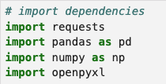
Data transformation
The data was captured in two formats: JSON and XLS.
The data was fed to a Jupyter NB where it was read using the following dependencies to clean the data: requests, pandas, numpy, openpyxl

Slide 4
Data transformation
Drop rows and columns
Sort values
Change datatypes from (FLOAT to INT)
Convert xls files to csv

Slide 5
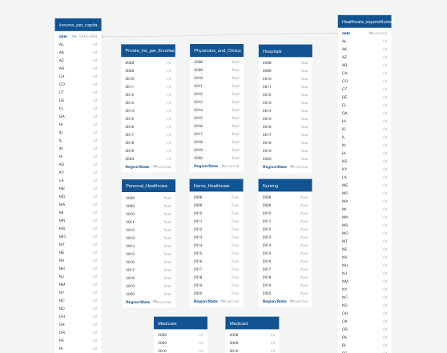
DATABASE
Used an ERD Schema to create tables
Housed the data we imported in SQL / Postgres
Then created unique datasets by combining this data

Slide 6
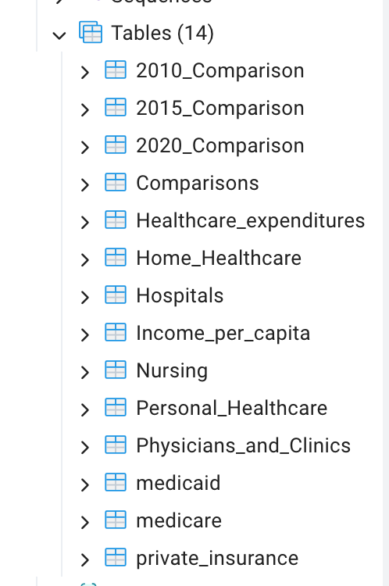
DATABASE and design
We used SQL because we were able to house the data in visible database where it can be analyzed and manipulated to examine relationships.

Slide 7
Additional Libraries
Openpyxl – used perform tasks on excel data.
Psycopg2 – Uses python code to connect to PostgresQL

Slide 8
Data delivery
This project used combined datasets designed in SQL and delivered via SQLalchemy, Pandas and Flask showing visualizations that represent our analysis topics:
Heathcare comparison of: Medicare, Medicaid, and Private Health Insurance spending
Regional per capita spending
US overall spending
Hospital Services, and Physician Clinic Services spending
State spending per capita

